Slide 1
Depthwise Separable Convolution based Passive Indoor Localization using CSI Fingerprint
Wenjing Xun, Lijuan Sun, Chong Han, Zhaoxiao Lin, Jian Guo College of Computer, Nanjing University of Posts and Telecommunications Jiangsu High Technology Research Key Laboratory for Wireless Sensor Networks Nanjing, China
2020 IEEE Wireless Communications and Networking Conference (WCNC)

Slide 2
Abstract
Most WIFI-based indoor localization systems have complex model and high localization delay.
Propose a depthwise separable convolution based passive indoor localization system (DSCP) using Wi-Fi channel state information (CSI)
Notes:
這篇論文的目標簡而言之就是要訓練出一個更輕量化，但效能好的model
本文使用的機器學習模型是 Depthwise separable convolution 中文來講叫做深度可分離卷積 ，以 channel state information 作為 feature，建立一個被動式的室內定位系統稱為 DSCP

Slide 3
Why Use WIFI
Many methods are used in indoor localization such as computer vision, ultrasonic, ultra-wideband, Bluetooth, RFID. However, these methods require a large number of hardware devices.
With the widespread adoption of Wi-Fi, Wi-Fi-based indoor localization methods have gradually become mainstream.
Notes:
計算機視覺、超聲波、超寬帶、藍牙、RFID(無線射頻辨識)
RFID簡單來講就是給目標物配戴一個會發射無線訊號的裝置，概念有點像是GPS的追蹤器
超寬帶是用脈衝波來傳送而不是正弦波，用於短距離的低功號高傳輸率應用
而上面這些方法對於室內環境來講，都需要而外的裝置，而WIFI在室內場合的普及率之高，很適合拿來使用

Slide 4
Related Work
[15]ConFi: Convolutional Neural Networks Based Indoor Wi-Fi Localization Using Channel State Information.
ConFi is the first CNN based model, and simulates CSI matrix as RGB image
[16]PILC: Passive indoor localization based on convolutional neural networks
Basically, PILC and ConFi are same, but PILC has higher accuracy with different hyper parameters.
Notes:
Reference [7]-[16]都是使用CSI來做WIFI indoor localization
這邊只介紹兩個，分別是ConFi跟PILC，是本篇論文實驗的比較對象
基本上兩個Model是一樣的，都是用CSI matrix作為RGB image餵給CNN訓練，兩者者的差別只是超參數的不同，後面

Slide 5
WIFI-Based Indoor Localization
Received Signal Strength (RSS) is easy to get. However, the value is unstable due to multipath effect.
Channel State Information (CSI) is the information provided by MIMO WIFI interface. It provides more information and is less sensitive with multipath effect.
Each set of CSI characterizes the amplitude and phase of orthogonal frequency division multiplexing (OFDM) subcarriers.
Passive localization localizes the target without carrying any electronic devices.
Notes:
RSS 是接收的訊號強度，而在室內中會因為障礙物而有多路境問題造成衰減而不穩定
相比於RSS，CSI雖需要多天線的WIFI interface，但對於現在的環境，也還算是普及
並且CSI可以做到passive localization，也就是定位目標不需要攜帶而外裝置

Slide 6
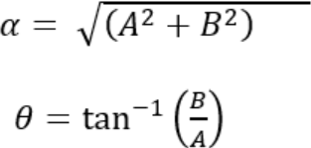
Channel State Information
Intel 5300 network interface card provides a matrix for 30 subcarrier sets.
Each packet contains 1x3x30 CSI matrix:
3 is the number of antennas.
30 is the number of subcarriers.
The value is complex number A+i.B of subcarrier amplitude and phase
In this paper, we get the amplitude matrix.
Notes:
這篇論文所使用的是Intel 5300網卡，就以它作為舉例，他提供了30組的subcarrier set
每個set的data如圖，每條線代表的是一個發送端天線與一個接收端天線的組合
每個天線因為是採用OFDM所以有很多個subcarrier，每個subcarrier都會估算出一個SNR數值
SNR指的是訊號強度與雜訊的比值，Psignal為訊號功率，Pnoise為雜訊功率，因此等於振幅的平方比
因為這裡用的單位是dB，所以要取log乘以10
不使用CSI相位的原因，這裡沒有明確的說，但我猜測是因為這個相位有需多的偏移，對於指紋來講這種不穩定性會有負面的影響
但實際上有處理方法，能透過線性處理來得到一個比較穩定的相位

Slide 7
CSI Fingerprints
Because signal is affected by multipath effect, the localization accuracy is low using a single signal-to-distance mapping.
Using the distinguishability of CSI at different location.
Two conditions:
The fingerprints of different locations have differences at the same time.
The fingerprints of the same location at different times are stable.
Notes:
由於CSI的資訊恰好能達成fingerprint的兩個條件
第一個是在不同的地點時要有不同的CSI matrix
第二個是每個地點的CSI matrix要穩定在不同時候不能有太大的差異

Slide 8
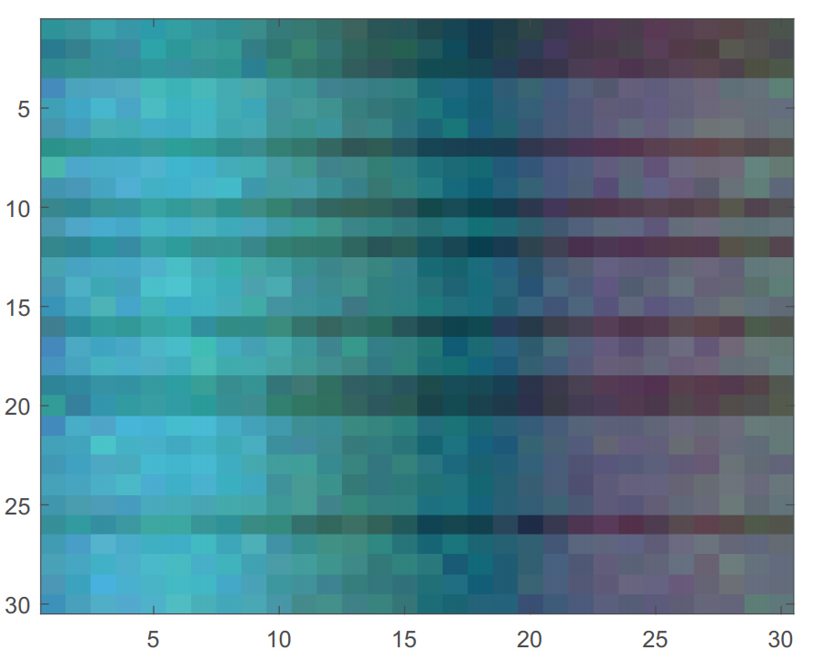

Model Input
This paper uses a sliding window to select 30 consecutive data packets in a sequence.
The input is a 30x30x3 matrix:
The first 30 is the size of the window
The second 30 is the number of subcarriers
3 is the number of a antennas
To enhance the difference between fingerprint this paper make a between adjacent subcarriers
Notes:
一個封包會有一個CSI matrix，先透過發送多個封包蒐集CSI matrix，然後以30長度的window去滑動取得30x30x3的matrix為model input
第一個30為window size
第二個30指的是subcarrier的數量
3為天線數量
這樣一個matrix就可以視為一張RGB圖片如右圖
而這篇論文提到為了強化fingerprint的差異性，他們提出透過相鄰的subcarrier相減後來作為model input

Slide 9
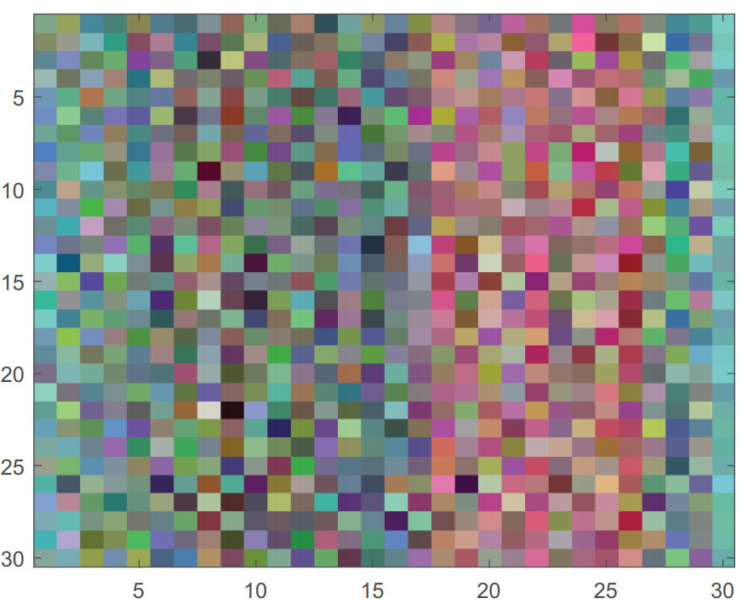
Model Input
CSI feature images based on subcarrier amplitudes
CSI feature images based on subcarrier amplitudes differences
Notes:
左邊是原始的CSI image
右邊是相減過後的CSI image
你看到的顏色差異能顯示出的是三根天線所取得的CSI具有差異，如果三個通道相近的話，顏色會呈現灰階的影像

Slide 10
Fingerprints-Based Localization
In the offline training phase, it is necessary to first divide the indoor scenario and set sampling point
In the online localization phase, the data collected at the target location is compared with the fingerprints in the fingerprint map
Notes:
怎麼來做localization呢? 首先是訓練階段，要對房間做sampling分成多個取樣點蒐集CSI image，以此做為訓練目標
預測階段時，就是用訓練好的model mapping蒐集到的CSI image

Slide 11
Depthwise Separable Convolution
Depthwise separable convolution is made up of a depthwise convolution and a pointwise convolution.
Normal convolution:
Input: 30 × 30 × M, Filter: (3 × 3 × M) × N, Output: 30 × 30 × N
Cost: H × W × M × N × K × K
Depthwise convolution:
Input: 30 × 30 × M, Filter: (3 × 3) × M, Output: 30 × 30 × M
Cost: H × W × M × K × K
Pointwise convolution is normal convolution layer, but the kernel size is 1x1xN
Input: 30 × 30 × M, Filter: (1 × 1 × M) × N, Output: 30 × 30 × N
Cost: H × W × M × N

Slide 12
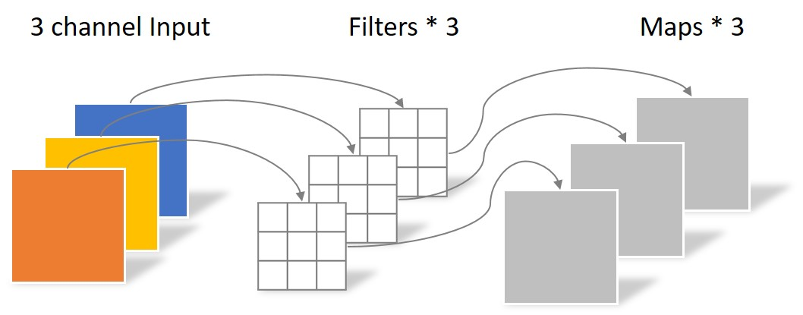
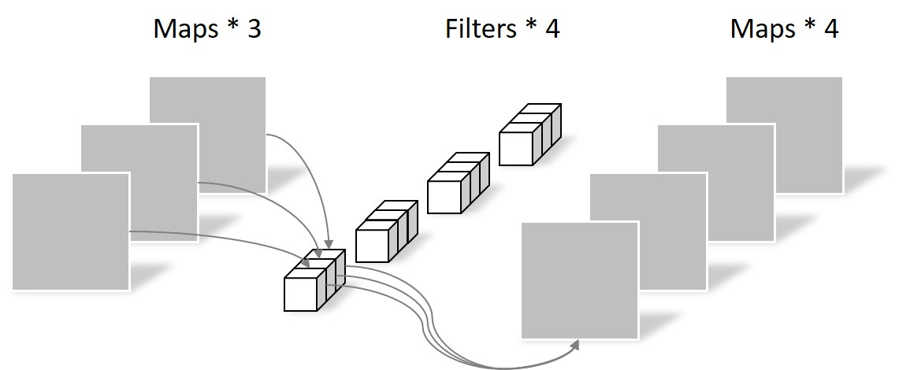
Depthwise Separable Convolution
Pointwise Convolution
Depthwise Convolution

Slide 13
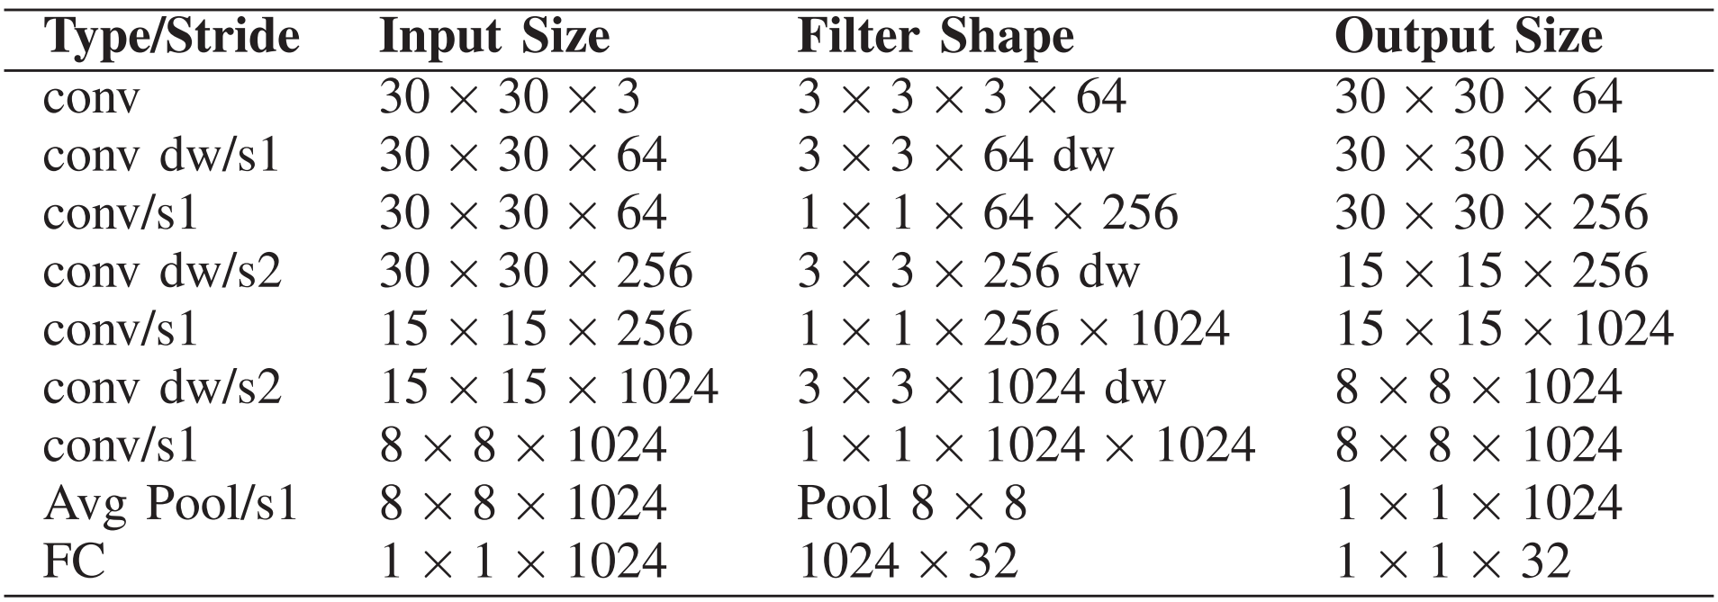
DSCP Network

Slide 14
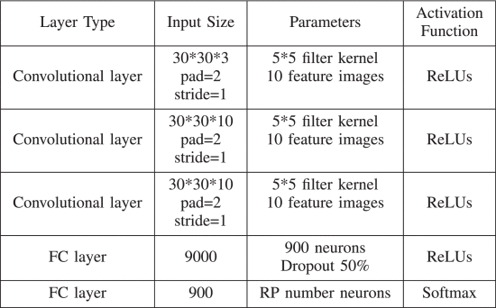
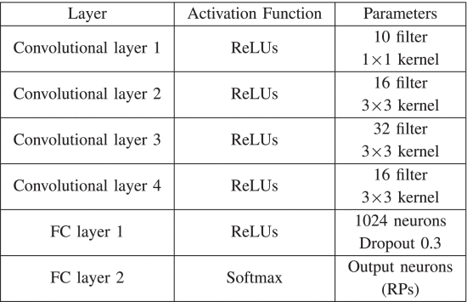
ConFi and PILC

Slide 15
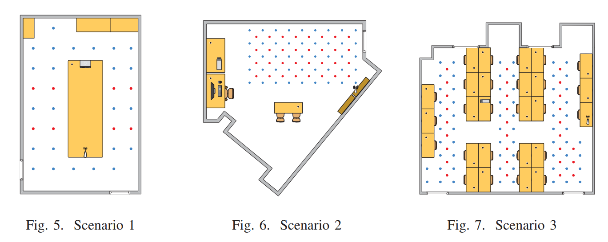
Data Collection
Notes:
場警1: 1M
場警2 、3: 0.6M

Slide 16
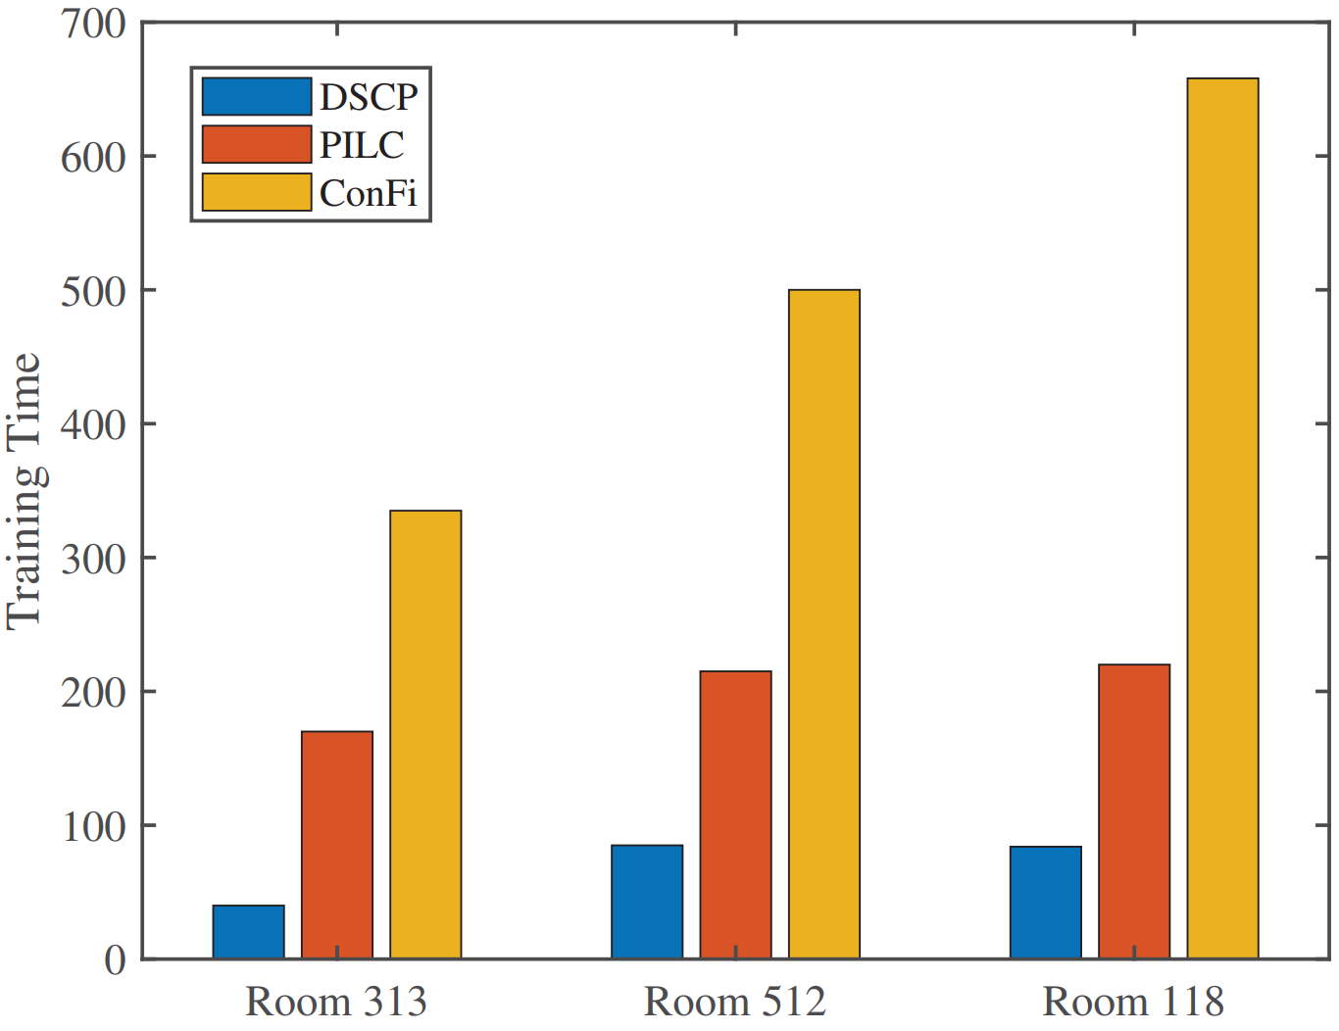
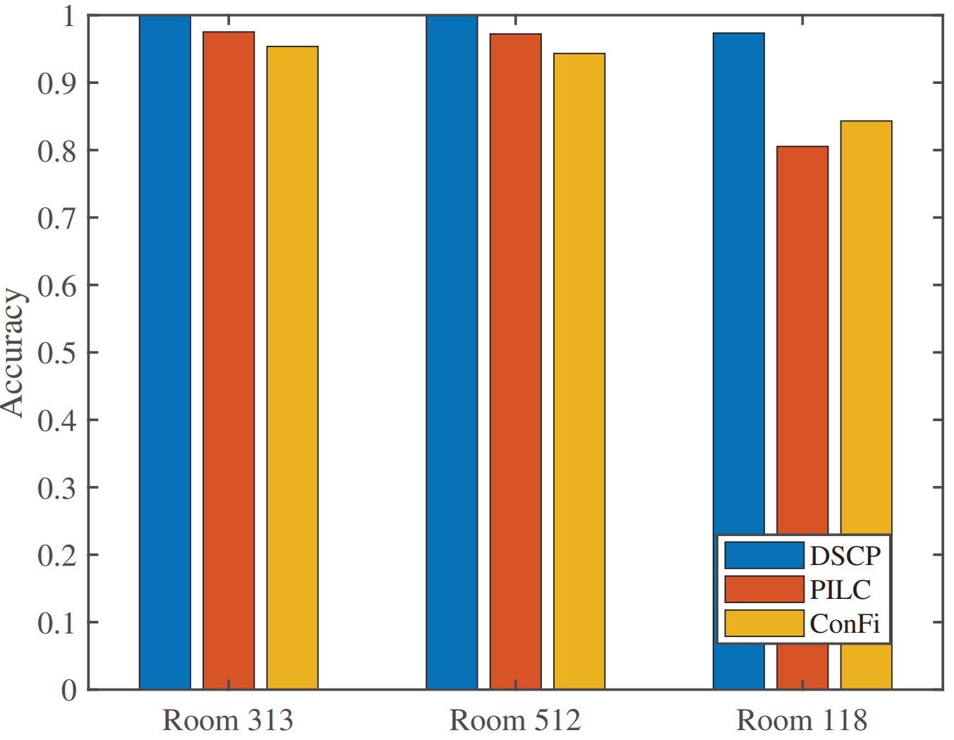
Model Evaluation
DSCP 30個epoch
PILC 60個epoch
ConFi 1200個epoch
Notes:
ConFi: Convolutional Neural Networks Based Indoor Wi-Fi Localization Using Channel State Information.
ConFi is the first CNN based model, and simulates CSI matrix as RGB image
PILC: Passive indoor localization based on convolutional neural networks
Basically PILC is same with ConFi, but PILC has higher accuracy with different hyper parameters.
DSCP 30個epoch
PILC 60個epoch
ConFi 1200個epoch

Slide 17
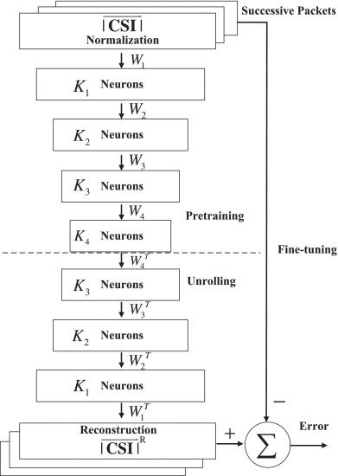
DeepFi
Notes:
本文在比較Performance時，又加上了DeepFi作為比較對象，本文沒有詳細的說明DeepFi，原本以為他只是MLP，但我稍微看了一下，他其實是用AutoEncoder來訓練模型的
有時間再細講

Slide 18
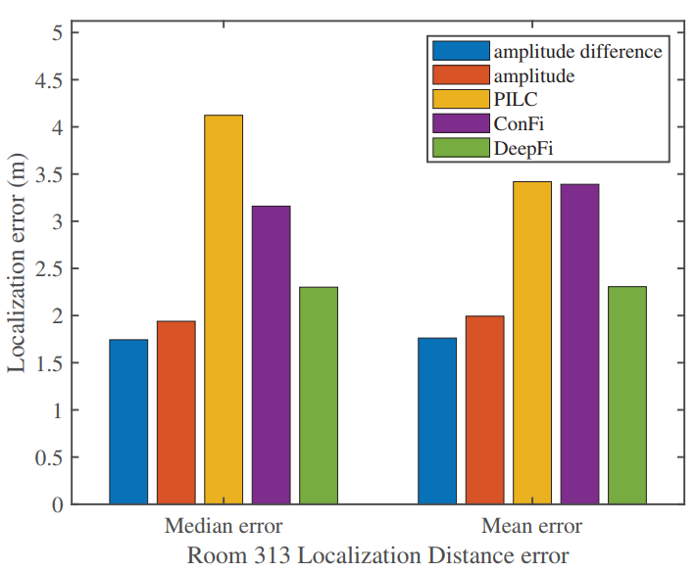
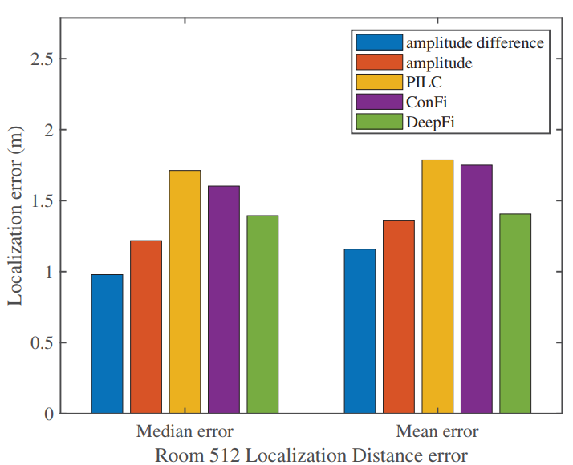
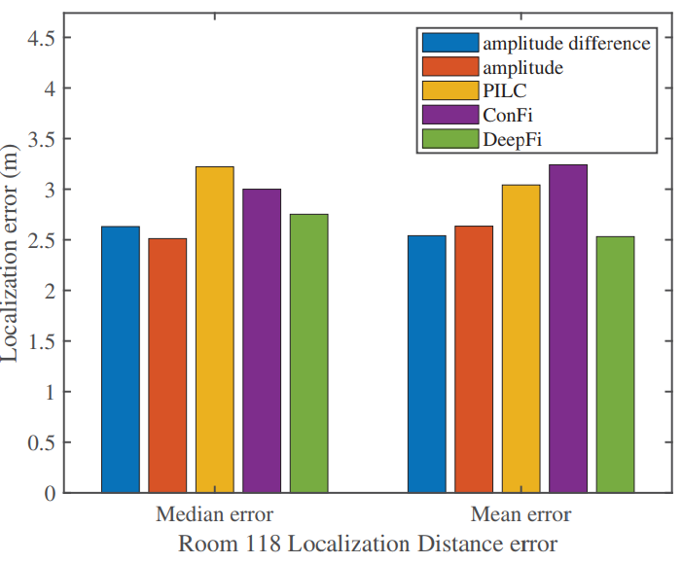
Localization Performance
Notes:
這裡又加上了DeepFi比較，本文沒有詳細的說明DeepFi，不過簡單來講，他就是使用MLP來訓練模型

Slide 19
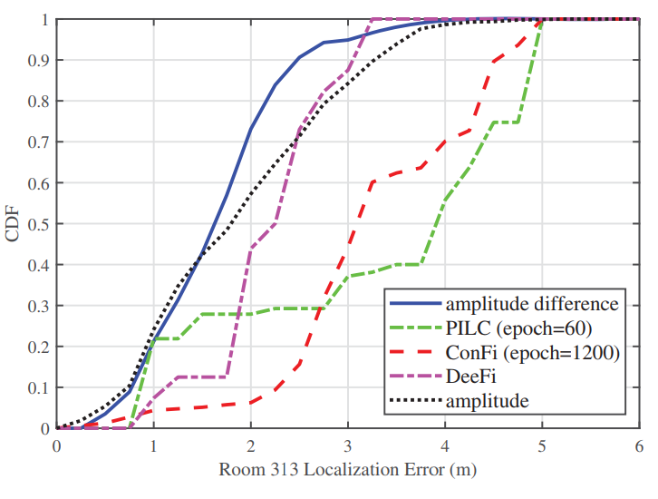
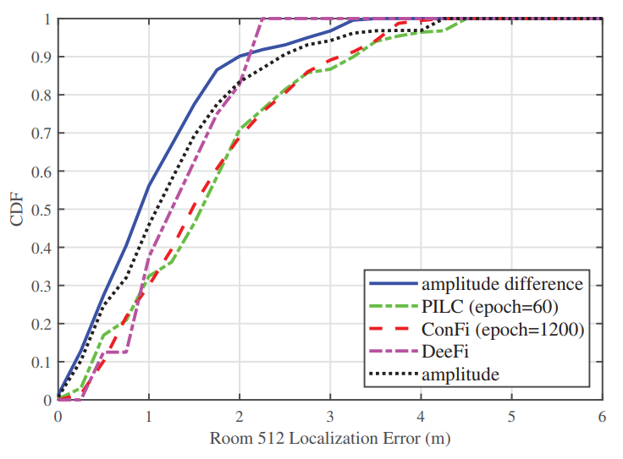
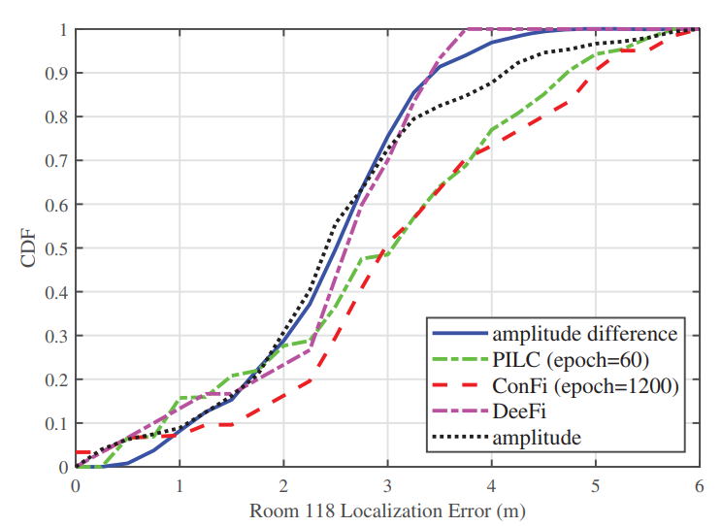
Result

Slide 20
Conclusion
Contribution:
Use the differences of subcarriers to enhance the fingerprint differences.
A high accurate and lighter model.
Suggestion:
Can provide the prediction time to show the delay of each model.

Slide 21
QA Time

